Slide 1

Assessment Self-presentation
Java (L3 -> L4)
Sumant Dharkar
March 2024
CONFIDENTIAL | © 2024 EPAM Systems, Inc.

Slide 2
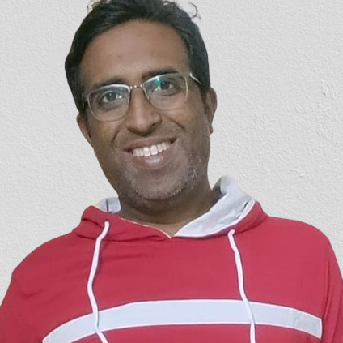
Total Experience 10 years, 3.6 years in EPAM
Current title
- Currently working as a Senior Software Engineer
Key skills
- Java, Spring, Spring Boot, Microservices (intermediate)
- Detailed understanding of requirements and design solution based on it
- Establishing good communication with stakeholders
Focus Area
- Product development in brownfield as well as greenfield projects.

Slide 3
Working experience/career path
2018
Hexaware-SITA (Developer)
Title: Senior Software engineer
2020
EPAM – MACD-RGSL (Developer)
Title: Senior Software engineer
2023
EPAM – TRI-HiQ
(key developer, Resource Manager)
Title: Senior software engineer
2024
EPAM – TRI-HiQ
(key developer, Resource Manager)
Title: Senior software engineer

Slide 4
Faster – TTV, Thomson Reuters
Example:
PROJECT
MY KEY ACHIEVEMENTS/DUTIES
This project is developed to ease the client’s onboarding process by automating all manual processes.
Creation of a robust and scalable code.
Timely completion of key development milestones.
Successful implementation of critical features and functionalities.
Achievement of 90% test coverage and identification/resolution of critical issues.
Implementation of robust security measures to protect sensitive data.
Completion of comprehensive documentation for the codebase, architecture, and user manuals.
Appreciation, Positive feedback and satisfaction from client for the work and deliverables.
ARCHITECTURE
Monolith spring boot base application
MY ROLE
DURATION
Key developer
February 2023 - Present
USED TECHNOLOGIES
TEAM
Java
Spring Boot, REST
Snowflake, SQL Server
Key developer in a team of 3 Devs, 1 QA, 1 BA

Slide 5
Contribution to EPAM and non-project activities
Certified as a Technical Interviewer along with a record of conducting over 600 interviews for EPAM and ensuring the selection of top-tier talent.
Contributed as an active member of the organizing committee for the Culture of Togetherness, taking ownership of and successfully orchestrating 4+ impactful events.
Engaged in mentoring activities within RD initiatives, providing guidance to around 100 college students.
Helping in staffing of associates for the client.
Conducted project fitment interviews for approximately 30 candidates, aligning their skills and expertise with specific project requirements.
Currently working as a Resource Manager for 7 members working under TR-HiQ projects. Helping them in their issues related to project, team, work etc. Also, conduction one on one, goal settings etc.

Slide 6





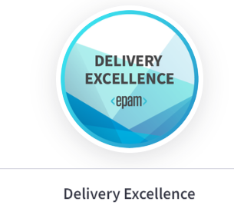

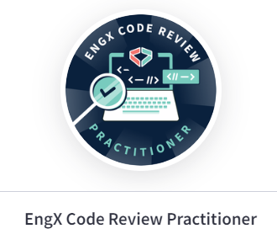




EPAM Badges

Slide 7
Goals for future
Advance and excel in my role as a team leader.
I aim to evolve and thrive in the role of a solution architect.
Contribute significantly to various EPAM initiatives.

Slide 8
Thank you!

